Slide 1
AI Fundamentals for Healthcare
Session 1 of 4 — How Machines Learn

Slide 2
Randy Giffen
Analytic Solution Architect
National Innovation Team
IBM Canada
randy_giffen@ca.ibm.com

Slide 3
Goal
Understand what machine learning actually does, and where it genuinely helps
Demystify the technology, so the vocabulary stops being a barrier
Recognise the strengths, and be precise about the weaknesses
Know what to ask when someone brings you a model

Slide 4
A Four-Part Series
Session 1 — How Machines Learn
  What machine learning is, how a model is trained, and why it is not programming
Session 2 — Classical Machine Learning
  The model families you will meet, and how to tell whether one works
Session 3 — Deep Learning and Generative AI
  Neural networks, large language models, and what safe deployment demands
Session 4 — From Models to Agents
  When a model stops predicting and starts acting on your behalf
Bonus session — Introduction to Quantum Computing
Each session stands on its own. Every patient in the examples is simulated.
Notes:
Set expectations early. Each session is self-contained, so someone who misses one is not lost. Mention that the notebooks are runnable and use only simulated data, which usually settles the first privacy question before it is asked.
About 2 minutes.

Slide 5



Traditional
Industry
Experience
Tradition
Knowledge
Education
and Policy
Behaviour

Slide 6

Scientific
Industry
Experience
Tradition
Knowledge
Education
and Policy
Behaviour
Scientific Research

Slide 7

AI Assisted
Industry
Experience
Tradition
Knowledge
Education
and Policy
Behaviour
Scientific Research
Machine Learning

Slide 8
Traditional Information Technology
We use information technology to store, process, retrieve, and present data and to help automate tasks
We are familiar with the idea of programming a computer to perform these tasks
Programming involves providing a specific set of detailed instructions to the computer
It then carries out these instructions precisely and rapidly

Slide 9
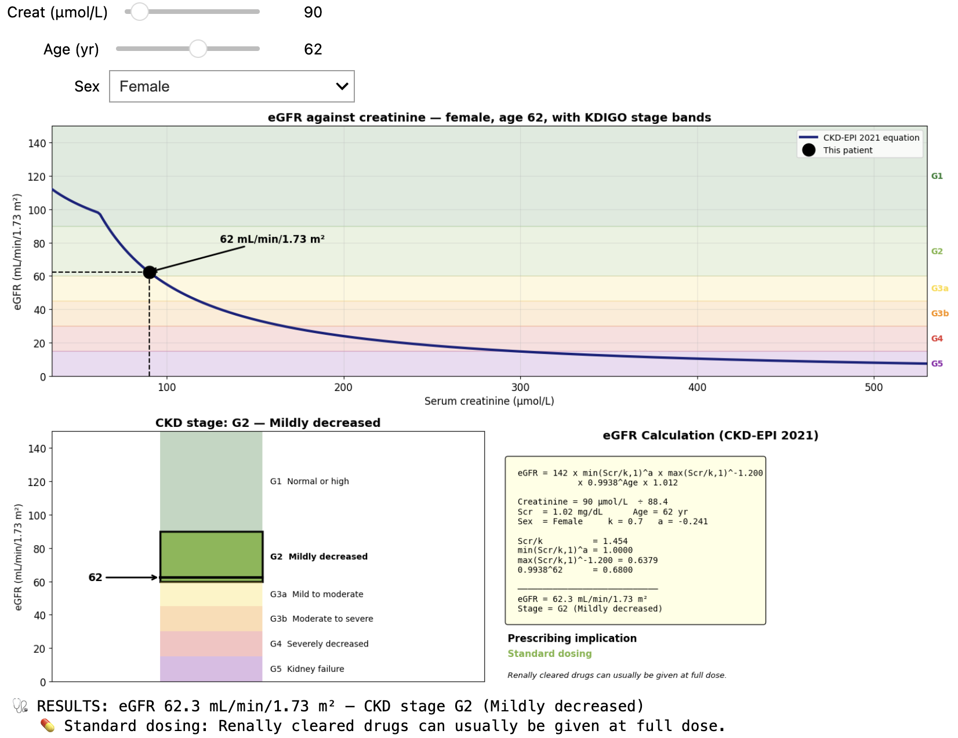

Slide 10
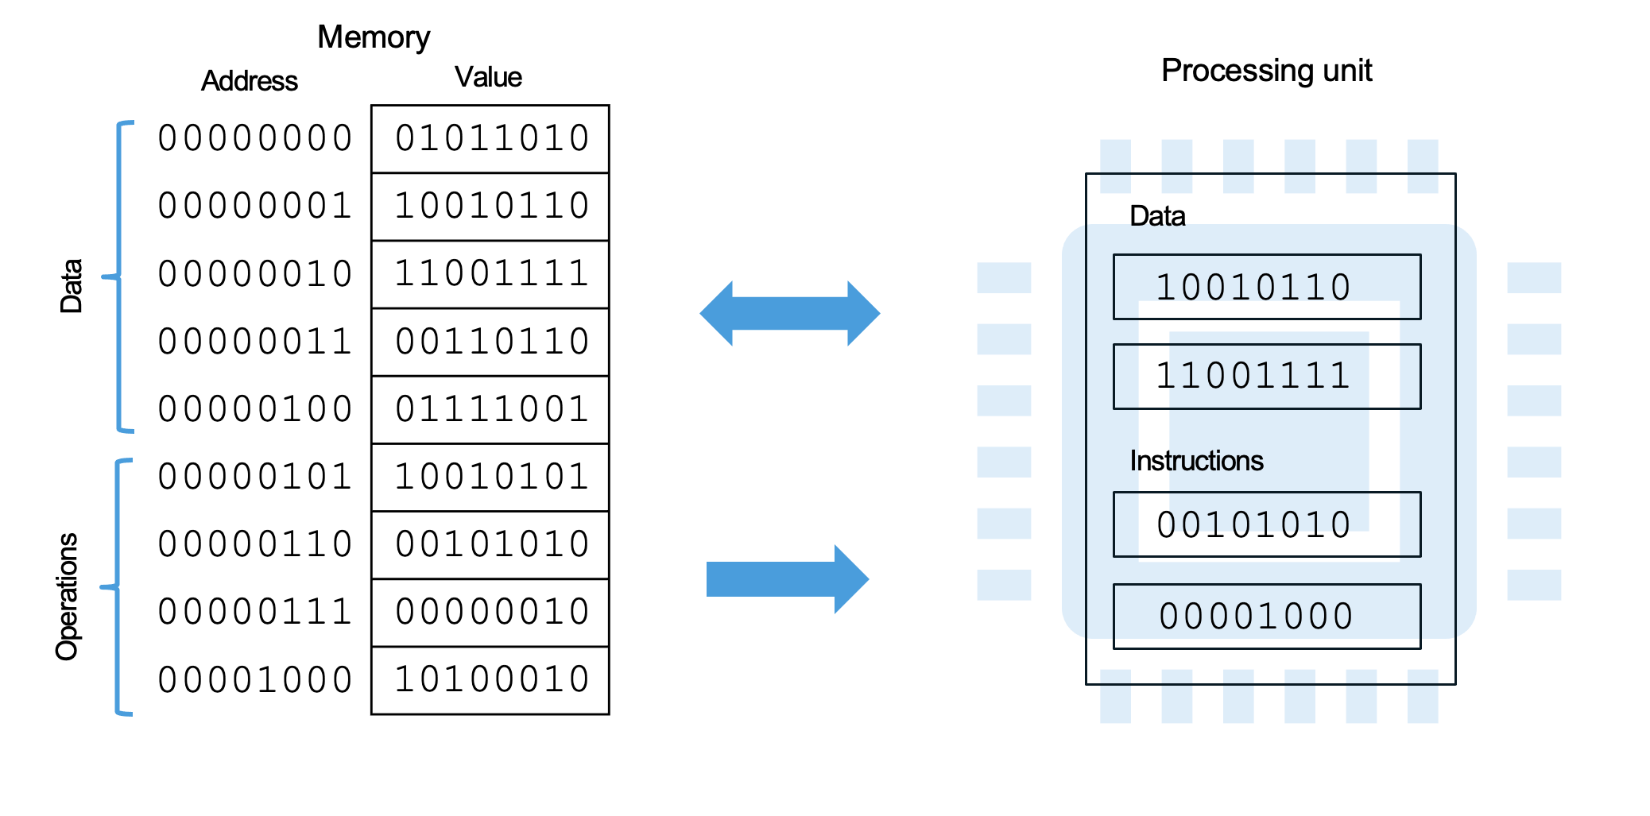
Information Technology - Precise Digital (Binary) Computer

Slide 11
Programming Language
Source Code (Script)
Compiler (Interpreter)
Instructions
01011100
10010110
11001111
00100110
01101001
10010101
00101110
00000010
10100010
x = 10
y = 3.2 * x + 12
print(y)

Slide 12
Limits of Traditional Information Technology
Some tasks are difficult to express exactly as a program
If we attempt to provide a set of rules, we quickly get overwhelmed by all the possible situations
The task may be something that we have learned by experience and therefore it can be very difficult to express it in terms of precise instructions for a machine
We need a more intelligent approach

Slide 13
Artificial Intelligence
Machine Learning

Slide 14
Foundations of Machine Learning
Learning Algorithm
ML
Data
Compute

Slide 15
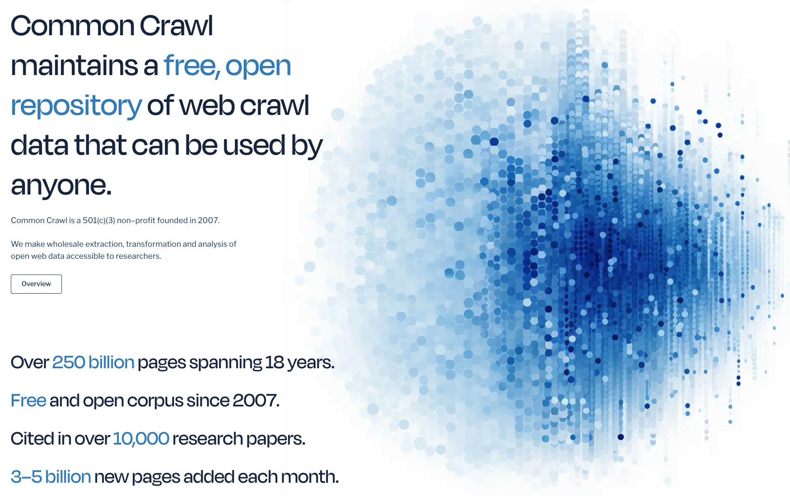
Data – Common Crawl https://commoncrawl.org/

Slide 16
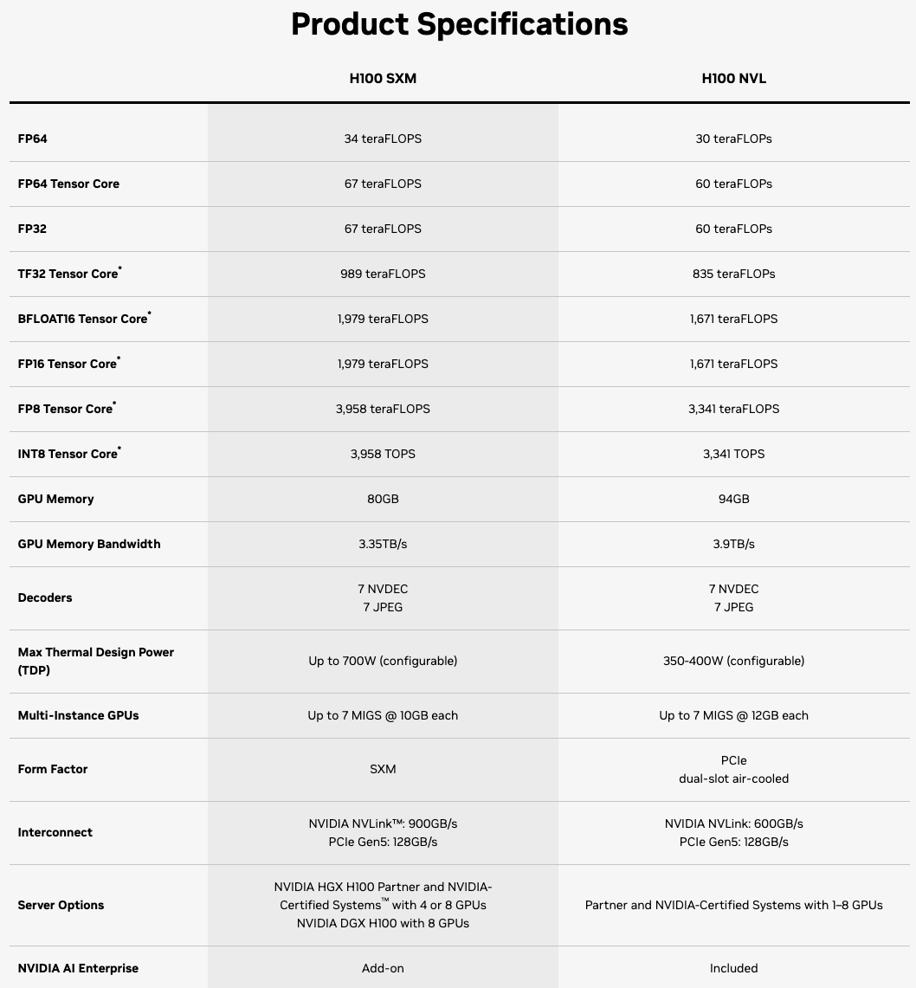
Compute – Graphical Processing Unit (GPU)
Parallel
Processing

Slide 17
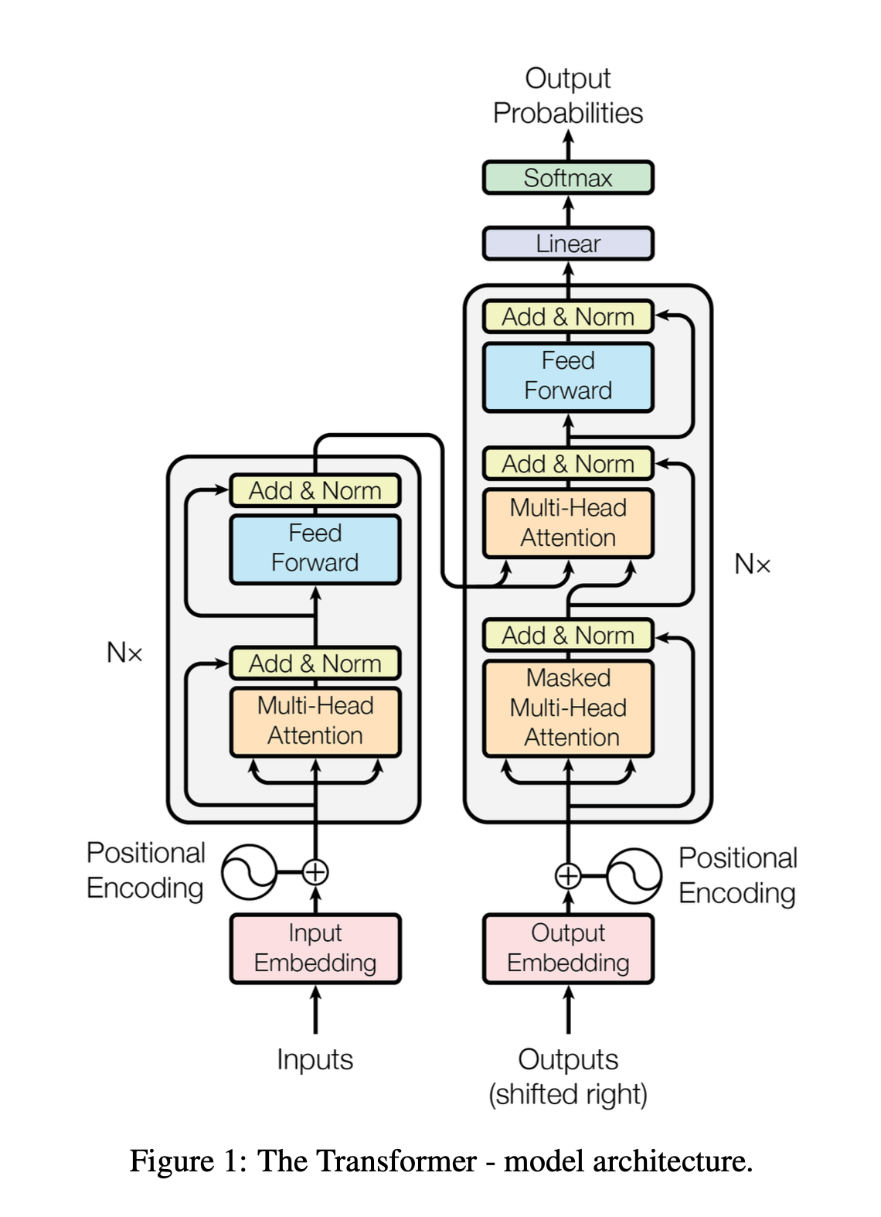
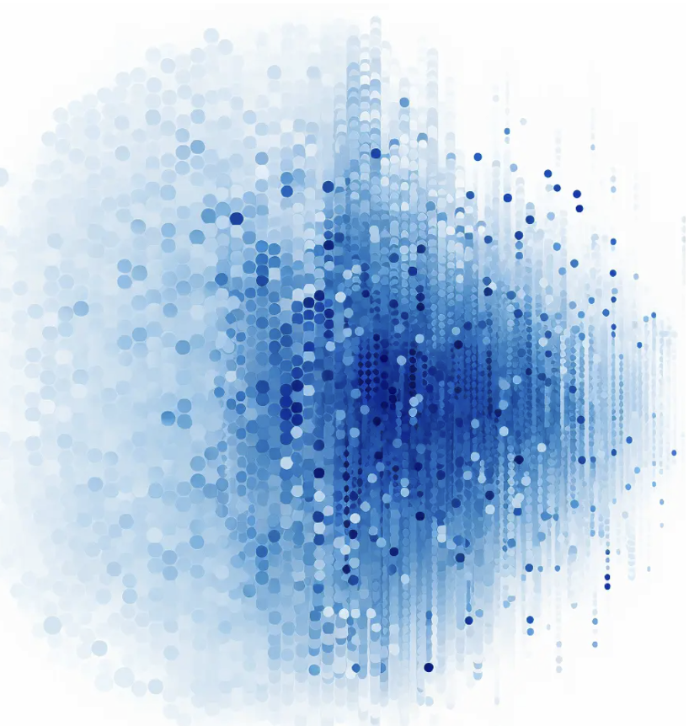
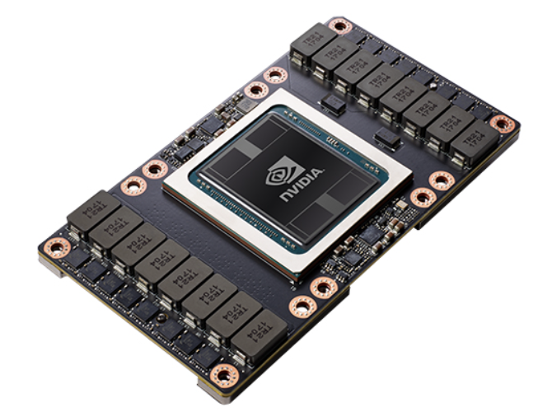
Foundations of Machine Learning – ex. Large Language Model
Learning Algorithm
Data
ML
Compute

Slide 18

Configuration from Data
Input
Features
Encoded Input
Features
Learning Algorithm
Encoded Output
Features
Output
Features
Hyperparameters
Parameters

Slide 19
Configuration from Data
Input
Features
Encoded Input
Features
Learning Algorithm
Encoded Output
Features
Output
Features
Hyperparameters
12.3
5.5
2.2
dark
early
Parameters

Slide 20
Configuration from Data
Input
Features
Encoded Input
Features
Learning Algorithm
Encoded Output
Features
Output
Features
0.32
0.75
0.11
0
0
1
1
0
Hyperparameters
12.3
5.5
2.2
dark
early
Parameters

Slide 21
Configuration from Data
Input
Features
Encoded Input
Features
Learning Algorithm
Encoded Output
Features
Output
Features
0.32
0.75
0.11
0
0
1
1
0
Hyperparameters
12.3
5.5
2.2
dark
early
Parameters

Slide 22
Configuration from Data
Input
Features
Encoded Input
Features
Learning Algorithm
Encoded Output
Features
Output
Features
0.32
0.75
0.11
0
0
1
1
0
Hyperparameters
12.3
5.5
2.2
dark
early
0.34
0.12
0.94
0.54
Parameters
3

Slide 23
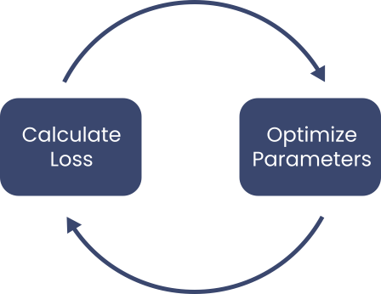
Training
Issues
Training Speed
Overfitting

Slide 24
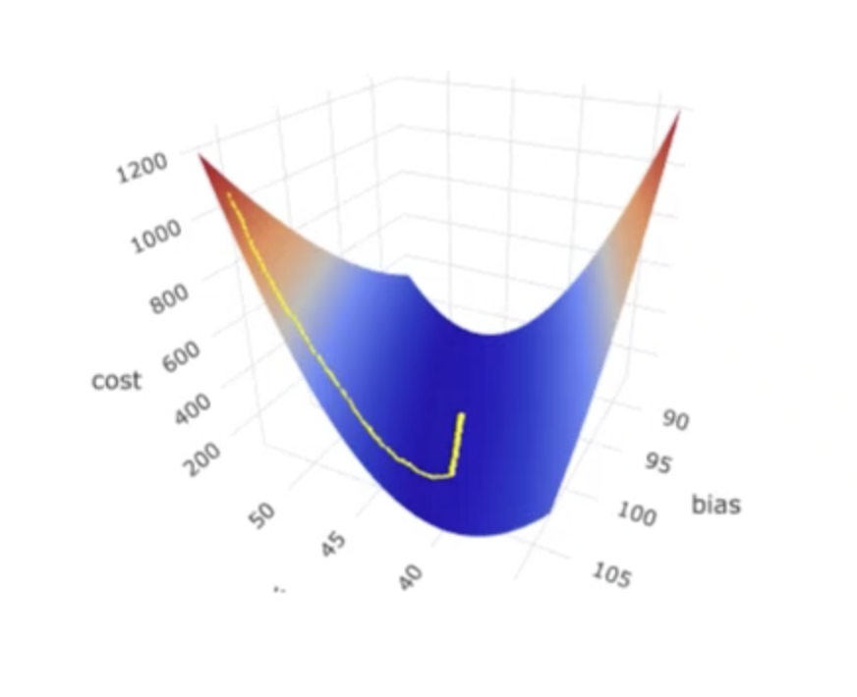
Optimization – Reduce the Loss

Slide 25
To learn, a model needs to be able to measure how far off it is from a good fit to the training data
It needs to measure how well it performs using its current parameter values. This measurement is called the loss (or cost), as in how far away it is from a good fit
During training, the loss should decrease
Training involves a cycle of using the loss function to calculate the loss and then adjusting the parameters slightly to improve the fit
This cycle is repeated many times
Mathematical Foundation – Optimization

Slide 26
The loss function of a machine learning model measures the “fitness” of the current output of the model
The goal is to have the model fitted to the information in the training data without having it overfitted to include the noise in the training data
This process is called optimization
If the value of the loss function were plotted on a graph vs the parameters, it would show a slope (or gradient) from areas of high loss to low loss
Thus, it is called gradient descent
The parameter values of each cycle form a path from high loss down the gradient to low loss
Mathematical Foundation – Loss Function

Slide 27
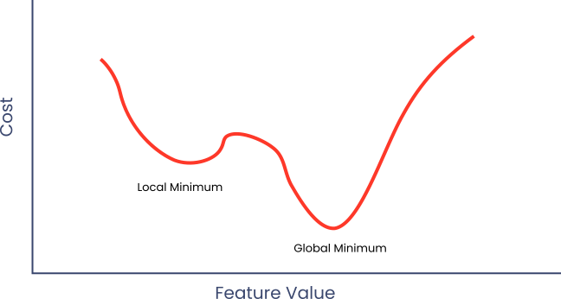
Complex Cost Functions

Slide 28
Configuration from Data
Input
Features
Encoded Input
Features
Learning Algorithm
Encoded Output
Features
Output
Features
0.32
0.75
0.11
0
0
1
1
0
Hyperparameters
12.3
5.5
2.2
dark
early
0.04
0.88
0.19
0.31
Parameters
2

Slide 29
Training vs Running
Slow
Historical
Data
Model
Training
Testing
Parameters
Fast
New
Data
Model
Running
Recommendation

Slide 30
Artificial Intelligence
Machine Learning
Neural Networks
Deep Learning

Slide 31
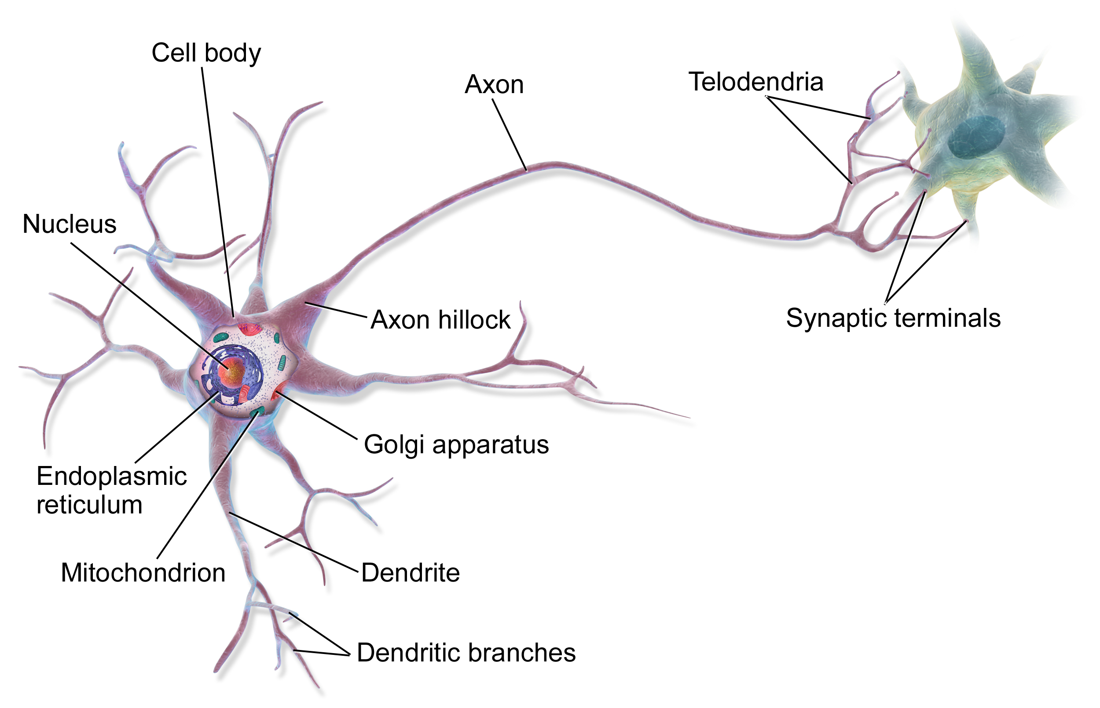
Neural Networks – Similar to Neurons
en.wikipedia.org/wiki/Neuron

Slide 32
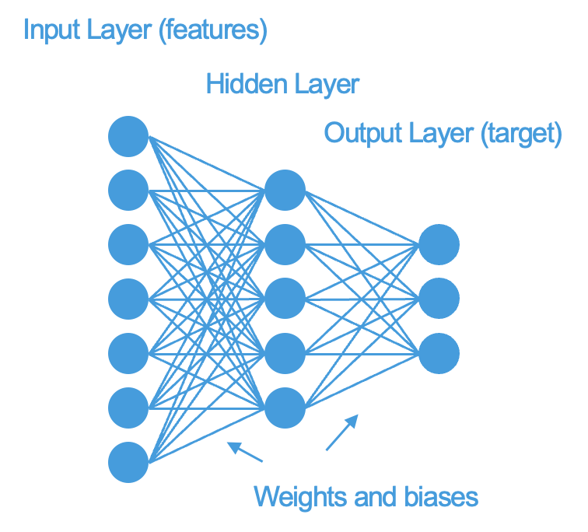
Deep Learning

Slide 33
Deep Learning

Slide 34
Types of Machine Learning
Supervised –
Labeled Data
Unsupervised – Unlabeled Data
Classification
  Predict a discrete value (label)
Regression
  Predict a continuous value (number)
Classification (clustering)
  Predict a discrete value
Autoencoder
Semi-supervised
Reinforcement

Slide 35
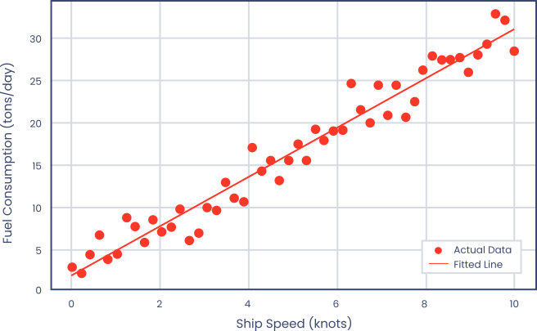
Linear Regression
Simple Linear Regression

Slide 36
Session 1 — What to Take Away
Programming states the rules. Machine learning infers them from examples.
A model is a set of parameters, fitted by repeatedly measuring error and adjusting.
Training is slow and happens once. Running the trained model is fast and happens constantly.
The quality and coverage of the training data set the ceiling on everything that follows.
A model interpolates confidently and extrapolates badly. It has seen no situation it was not shown.
Next session: the model families you will meet in practice, and how to judge them.
Notes:
Do not read these out. Ask the room which one surprised them most and let that run.
The point worth labouring is the last one: a model has seen no situation it was not shown. Every failure later in the series is a version of that sentence.
About 4 minutes including discussion.

Slide 37
Questions?

